Slide 1
Probability - 4
Expected Value, Normal Distribution

Slide 2
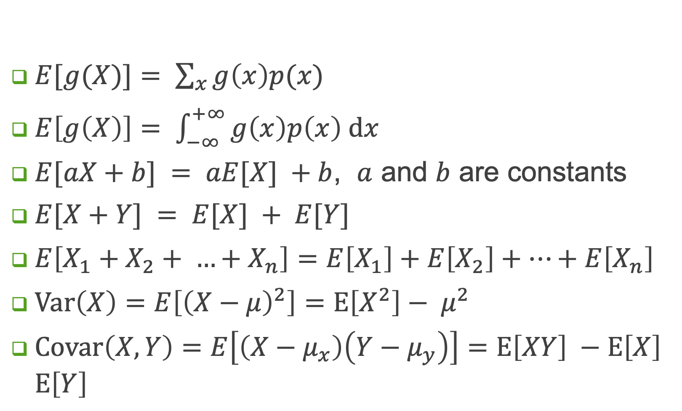
Properties – 1/2
$E[g(X)]= \sum_{x}{g\left(x\right)p(x)}$
$E\left[g\left(X\right)\right]= \int_{−∞}^{+∞}{g\left(x\right)p\left(x\right) \text{d}x}$
$E[aX+b] = aE[X] +b$, $a$ and $b$ are constants
$E[X+Y] = E[X] + E[Y]$
$E\left[X_{1}+X_{2}+ …+X_{n}\right]=E\left[X_{1}\right]+E\left[X_{2}\right]+…+E\left[X_{n}\right]$
$\text{Var}\left(X\right)=E\left[{\left(X−μ\right)}^{2}\right]=E\left[X^{2}\right]− μ^{2}$
$\text{Covar}\left(X, Y\right)=E\left[\left(X−μ_{x}\right)\left(Y−μ_{y}\right)\right]=E\left[XY\right] −E\left[X\right]$ $E\left[Y\right]$

Slide 3
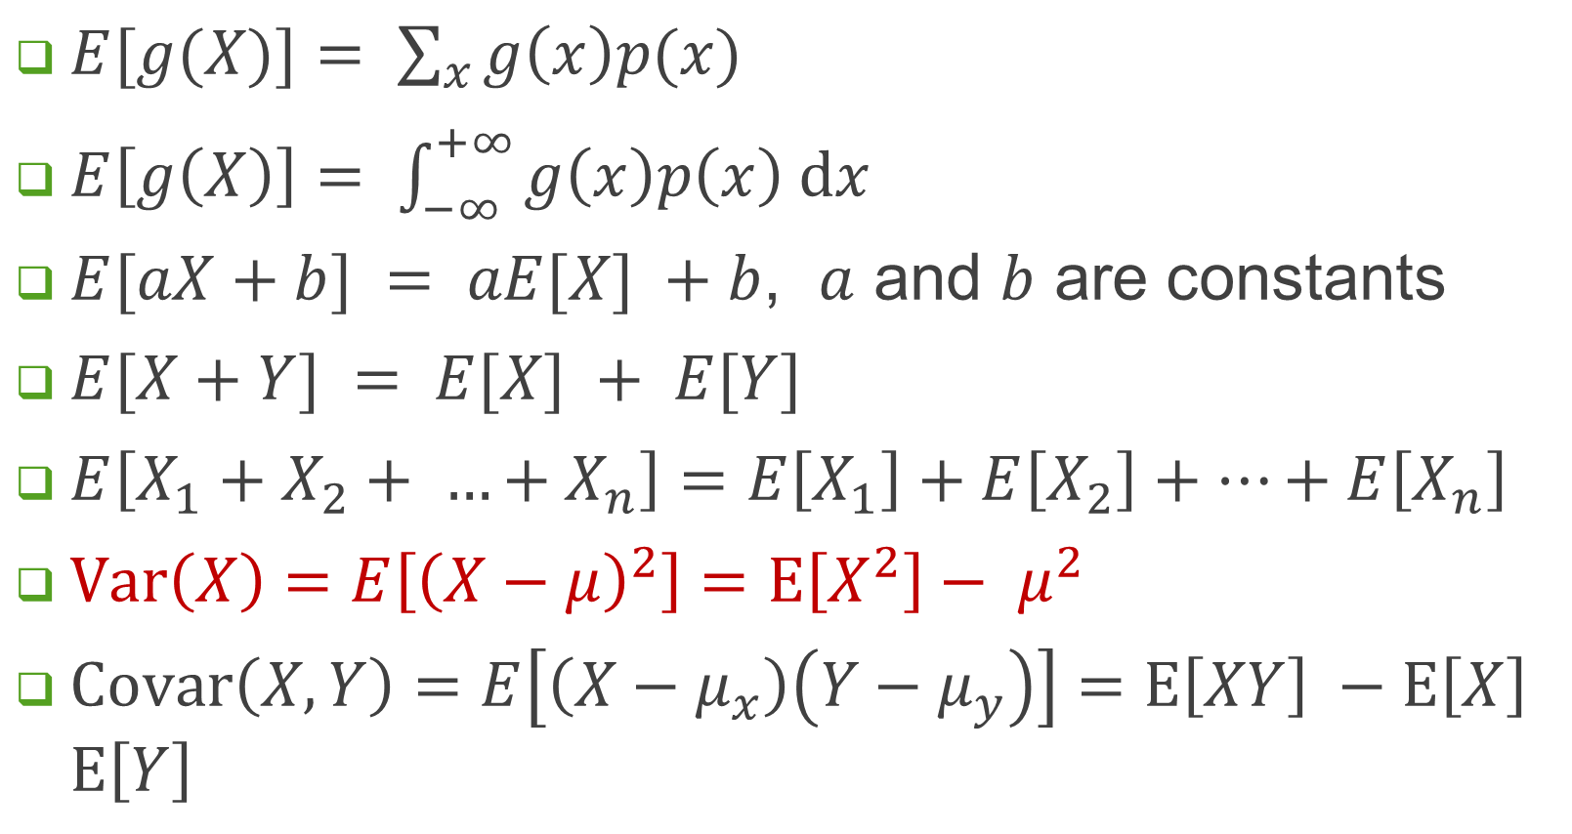
Properties – 1/2
$E[g(X)]= \sum_{x}{g\left(x\right)p(x)}$
$E\left[g\left(X\right)\right]= \int_{−∞}^{+∞}{g\left(x\right)p\left(x\right) \text{d}x}$
$E[aX+b] = aE[X] +b$, $a$ and $b$ are constants
$E[X+Y] = E[X] + E[Y]$
$E\left[X_{1}+X_{2}+ …+X_{n}\right]=E\left[X_{1}\right]+E\left[X_{2}\right]+…+E\left[X_{n}\right]$
$\text{Var}\left(X\right)=E\left[{\left(X−μ\right)}^{2}\right]=E\left[X^{2}\right]− μ^{2}$
$\text{Covar}\left(X, Y\right)=E\left[\left(X−μ_{x}\right)\left(Y−μ_{y}\right)\right]=E\left[XY\right] −E\left[X\right]$ $E\left[Y\right]$

Slide 4
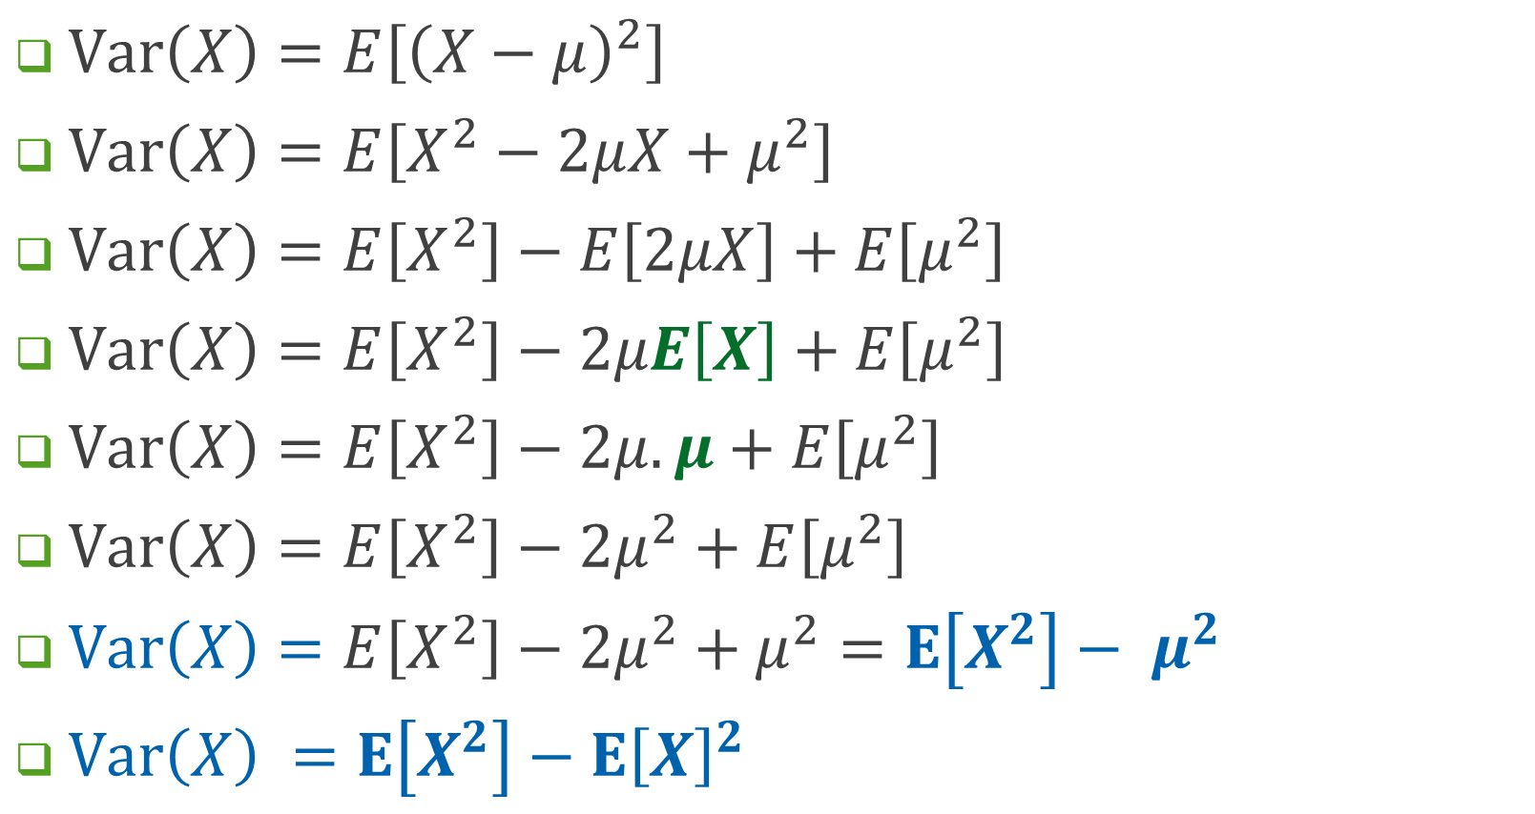
$\text{Var}\left(X\right)=E\left[{\left(X−μ\right)}^{2}\right]$
$\text{Var}\left(X\right)=E\left[X^{2}−2μ{X+μ}^{2}\right]$
$\text{Var}\left(X\right)=E\left[X^{2}\right]−E\left[2μX\right]+E\left[μ^{2}\right]$
$\text{Var}\left(X\right)=E\left[X^{2}\right]−2μE\left[X\right]+E\left[μ^{2}\right]$
$\text{Var}\left(X\right)=E\left[X^{2}\right]−2μ.μ+E\left[μ^{2}\right]$
$\text{Var}\left(X\right)=E\left[X^{2}\right]−2μ^{2}+E\left[μ^{2}\right]$
$\text{Var}\left(X\right)=E\left[X^{2}\right]−2μ^{2}+μ^{2}=$ $E\left[X^{2}\right]− μ^{2}$
$\text{Var}\left(X\right) =E\left[X^{2}\right]−{E\left[X\right]}^{2}$

Slide 5
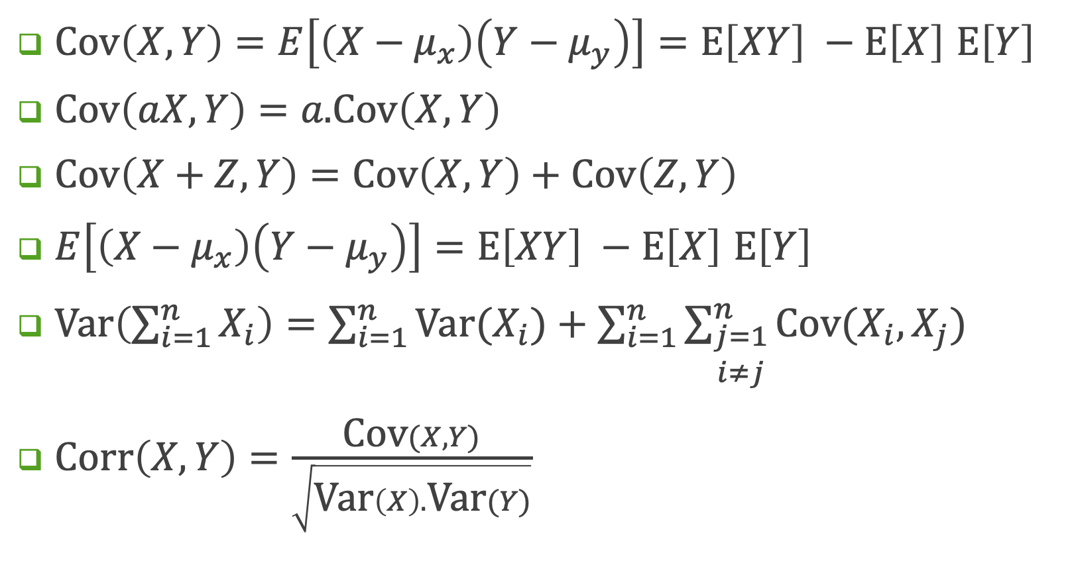
Properties – 2/2
$\text{Cov}\left(X, Y\right)=E\left[\left(X−μ_{x}\right)\left(Y−μ_{y}\right)\right]=E\left[XY\right] −E\left[X\right]$ $E\left[Y\right]$
$\text{Cov}\left(aX, Y\right)=a\text{.}\text{Cov}\left(X, Y\right)$
$\text{Cov}\left(X+Z, Y\right)=\text{Cov}\left(X, Y\right)+\text{Cov}\left(Z, Y\right)$
$E\left[\left(X−μ_{x}\right)\left(Y−μ_{y}\right)\right]=E\left[XY\right] −E\left[X\right]$ $E\left[Y\right]$
$\text{Var}\left(\sum_{i=1}^{n}{X_{i}}\right)=\sum_{i=1}^{n}{\text{Var}(X_{i})}+\sum_{i=1}^{n}{\sum_{\begin{matrix}j=1 \\ i≠j\end{matrix}}^{n}{\text{Cov}(X_{i}, X_{j})}}$
$\text{Corr}\left(X,Y\right)=\frac{\text{Cov}(X,Y)}{\sqrt{\text{Var}\left(X\right).\text{Var}(Y)}}$

Slide 6

Moments
$E\left[X^{n}\right] is called nth moment$
Moment can be obtained for a discrete /continuous random variable as follows:
Moments: Mean $(n = 1)$, Variance $(n=2)$

Slide 7
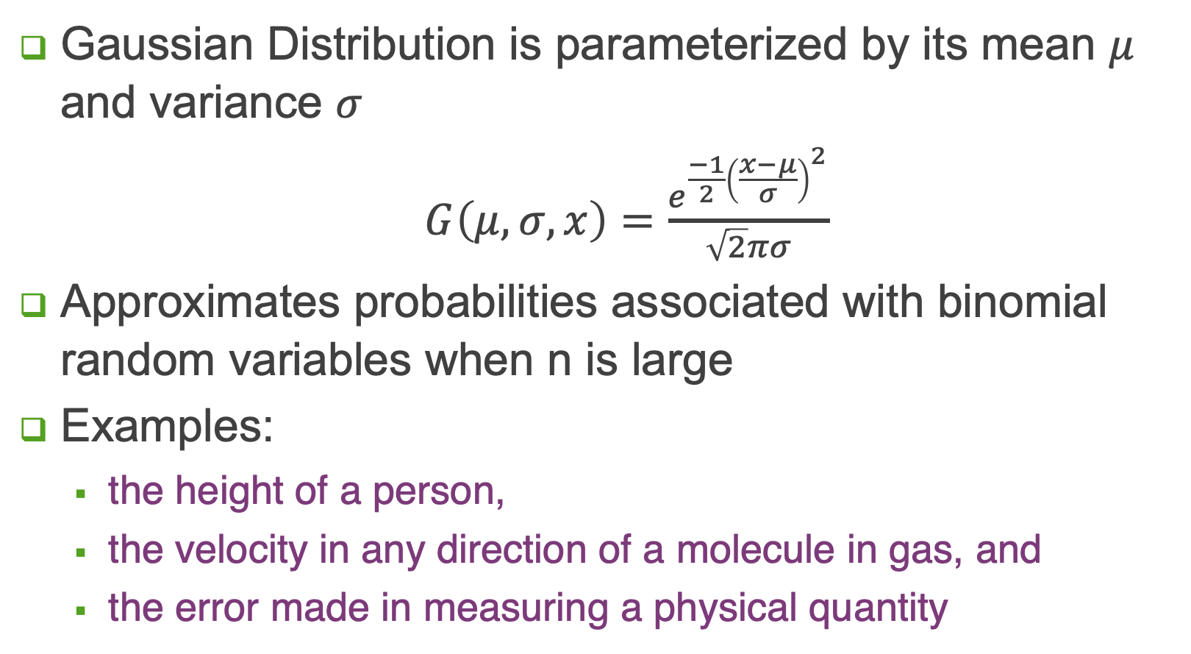
Gaussian Distribution
Gaussian Distribution is parameterized by its mean $μ$ and variance $σ$
$G\left(μ,σ, x\right)=\frac{e^{\frac{−1}{2}{\left(\frac{x−μ}{σ}\right)}^{2}}}{\sqrt{2}πσ}$
Approximates probabilities associated with binomial random variables when n is large
Examples:
the height of a person,
the velocity in any direction of a molecule in gas, and
the error made in measuring a physical quantity

Slide 8
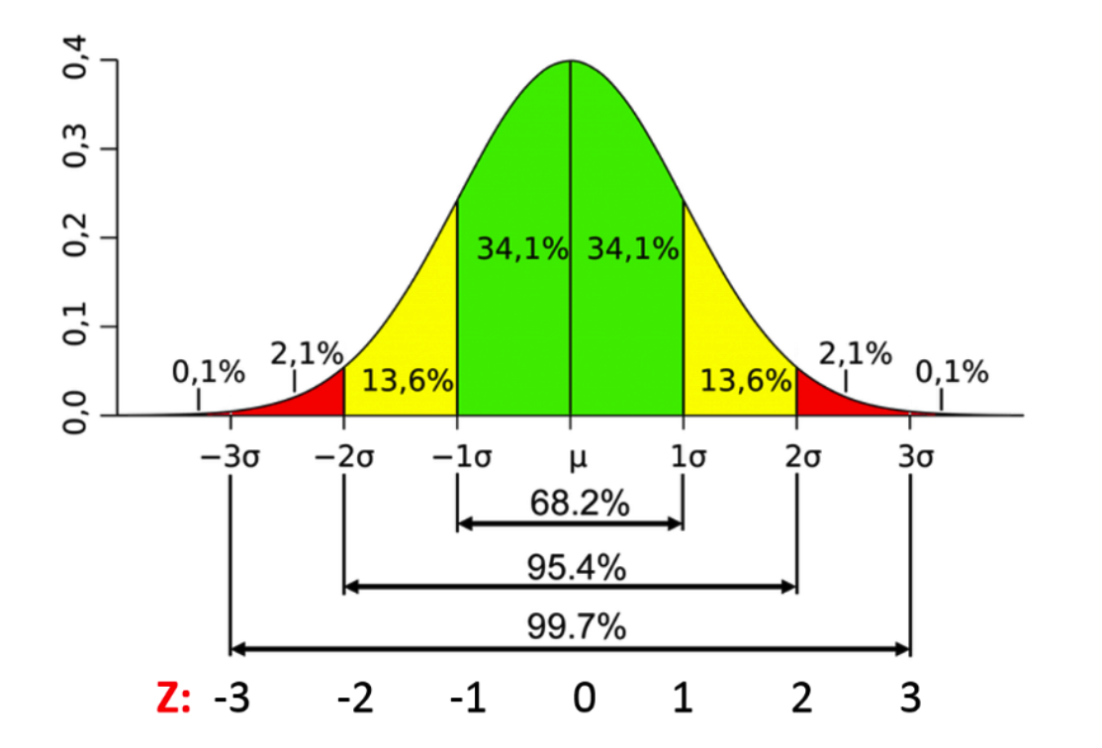
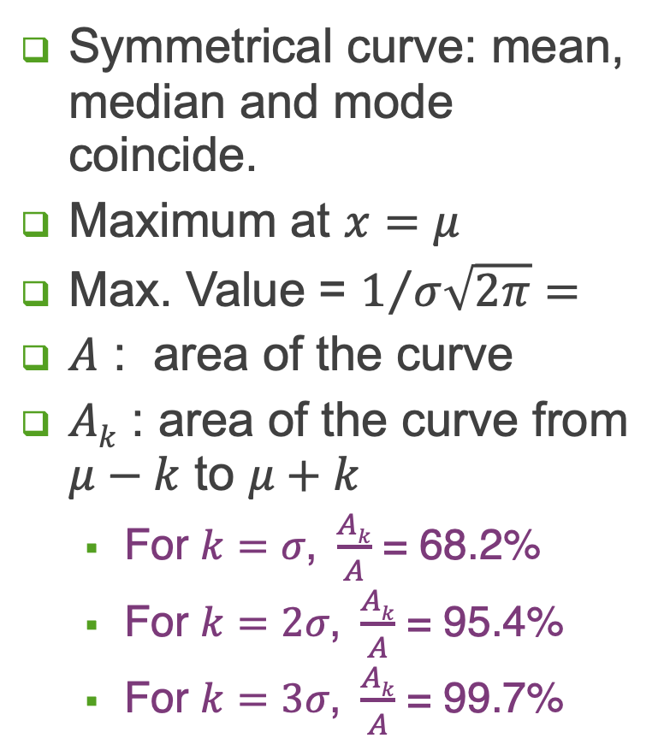
Gaussian Curve: Properties
Symmetrical curve: mean, median and mode coincide.
Maximum at $x=μ$
Max. Value = $1/{σ\sqrt{2π}=}$
$A$ : area of the curve
$Ak$ : area of the curve from $μ−k$ to $μ+k$
For $k=σ\text{, }\frac{Ak}{A}$ = 68.2%
For $k=2σ\text{, }\frac{Ak}{A}$ = 95.4%
For $k=3σ\text{, }\frac{Ak}{A}$ = 99.7%

Slide 9
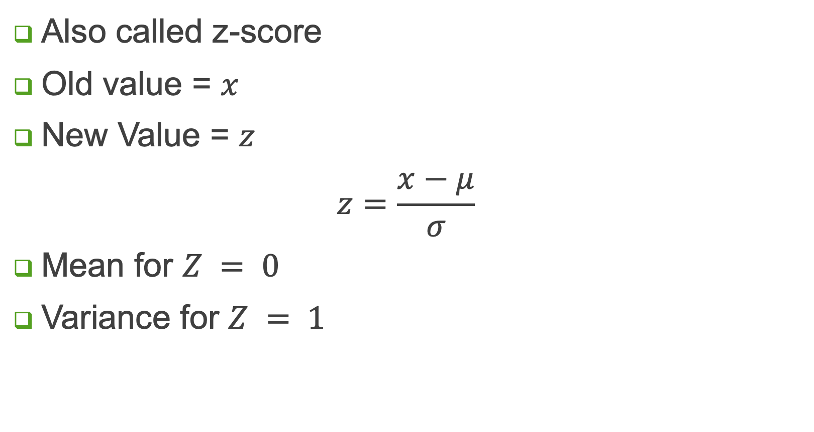
Standard Score
Also called z-score
Old value = $x$
New Value = $z$
$$z=\frac{x−μ}{σ}$$
Mean for $Z = 0$
Variance for $Z = 1$

Slide 10
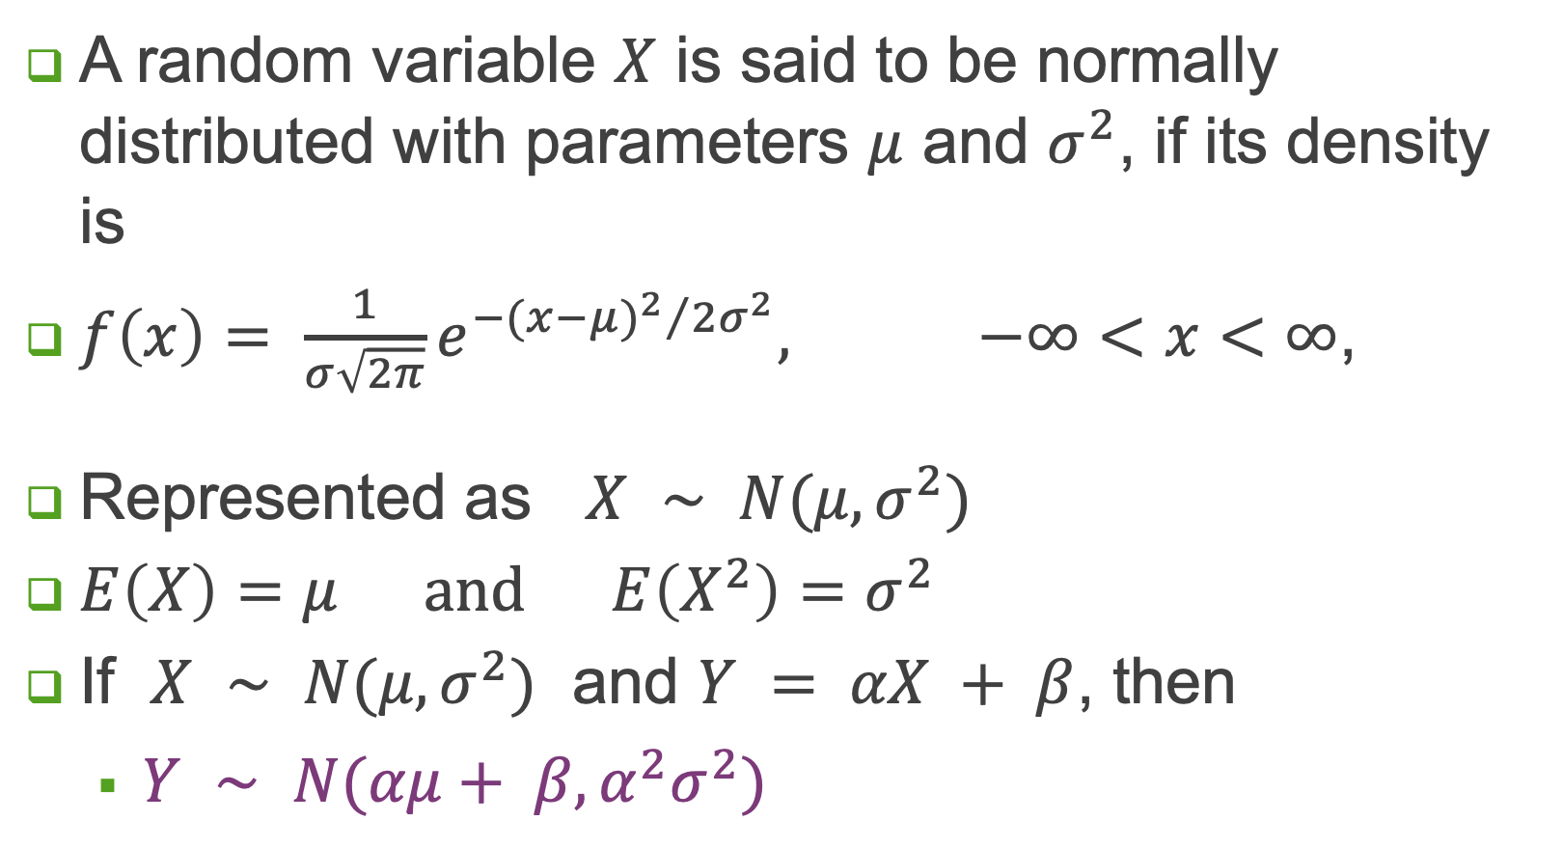
Normal Random Variable
A random variable $X$ is said to be normally distributed with parameters $μ$ and $σ^{2}$, if its density is
$f\left(x\right)= \frac{1}{σ\sqrt{2π}}e^{{−{(x−μ)}^{2}}/{2σ^{2}}}, −∞<x<∞$,
Represented as $X ∼ N(μ, σ^{2})$
$E\left(X\right)=μ and E\left(X^{2}\right)=σ^{2}$
If $X ∼ N(μ, σ^{2})$ and $Y = αX + β$, then
$Y ∼ N(αμ+ β,α^{2}σ^{2})$

Slide 11
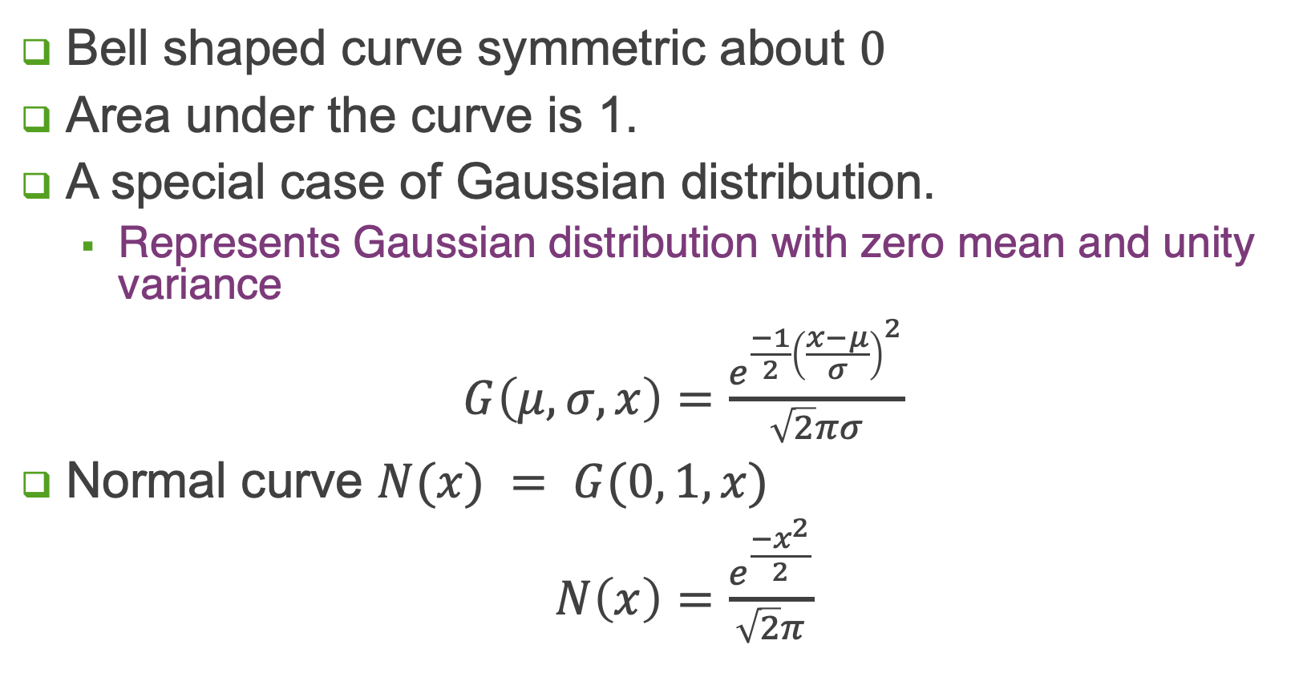
Standard Normal Distribution
Bell shaped curve symmetric about $0$
Area under the curve is 1.
A special case of Gaussian distribution.
Represents Gaussian distribution with zero mean and unity variance
$G\left(μ,σ, x\right)=\frac{e^{\frac{−1}{2}{\left(\frac{x−μ}{σ}\right)}^{2}}}{\sqrt{2}πσ}$
Normal curve $N(x) = G(0, 1, x)$
$N\left(x\right)=\frac{e^{\frac{{−x}^{2}}{2}}}{\sqrt{2}π}$

Slide 13
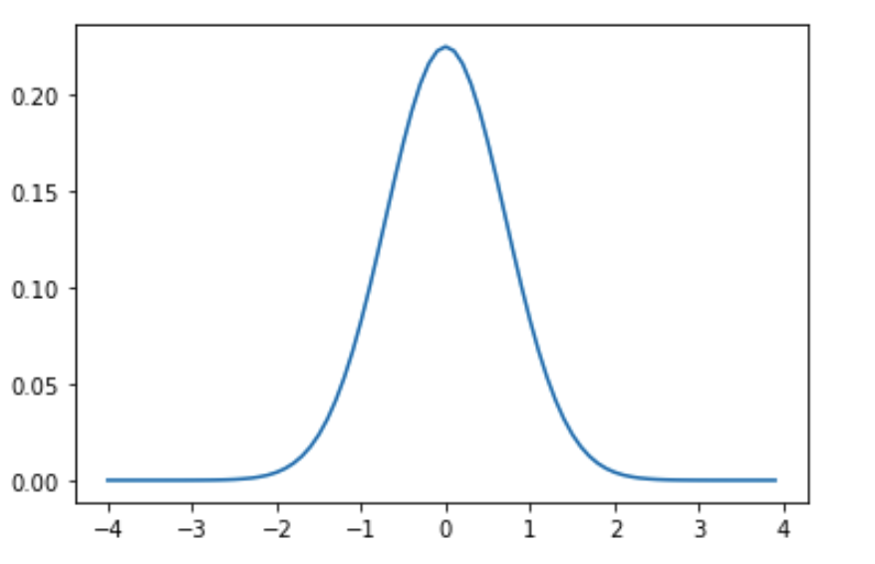
Normal tables
This table entry for $a$ indicates area under curve from $x=−∞$ to $x=a.$
This value is probability $P\left(x≤a\right)$
$P\left(x=a\right)=$ 0
$P\left(x>a\right)=1 −P\left(x≤a\right)$
$P\left(a< x≤b\right)=P\left(x≤b\right)$ $−$ $P\left(x≤a\right)$

Slide 14
Normal Curve: Example
Given that probability distribution of the IQ scores of population approximates a Gaussian with mean = 100 and deviation = 15, determine fraction of the population expected to have a scores greater than
90, 130, 150
You may use tables for normal distributions at https://www.math.arizona.edu/~rsims/ma464/standardnormaltable.pdf

Slide 15
Normal Curve: Example
Given that probability distribution of the IQ scores of population approximates a Gaussian with mean = 100 and deviation = 15, determine fraction of the population expected to have a scores greater than
90, 130, 150
Step 1: Convert scores to normalized (z-scores)
So value for 90 shall be (90-100)/15 = -0.667
So value for 130 shall be (130-100)/15 = 2
So value for 150 shall be (150-100)/15 = 3.333

Slide 16
Normal Curve: Example
Given that probability distribution of the IQ scores of population approximates a Gaussian with mean = 100 and deviation = 15, determine fraction of the population expected to have a scores greater than
90, 130, 150
Step 2: Check respective entries in normal table
So value for -0.67 = 0.25143 = 0.25
So value for 2 = 0.97725
So value for 3.33 = 0.99957

Slide 17
Normal Curve: Example
Given that probability distribution of the IQ scores of population approximates a Gaussian with mean = 100 and deviation = 15, determine fraction of the population expected to have a scores greater than
90, 130, 150
Step 3: Fraction of population with IQ score
> 90 (normalized value -0.67) = 1 - 0.25 = 0.75
> 130 (normalized value 2) = 1 - 0.97725 = 0.02275
> 150 (normalized value 3.33) = 1 - 0.99957 = 0.00043

Slide 18
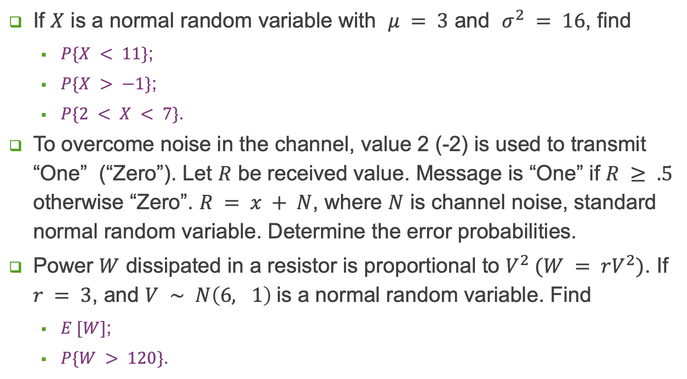
Exercises
If $X$ is a normal random variable with $μ = 3$ and $σ^{2} = 16$, find
$P\{X < 11\}$;
$P\{X > −1\}$;
$P\{2 < X < 7\}$.
To overcome noise in the channel, value 2 (-2) is used to transmit “One” (“Zero”). Let $R$ be received value. Message is “One” if $R ≥ .5$ otherwise “Zero”. $R = x + N$, where $N$ is channel noise, standard normal random variable. Determine the error probabilities.
Power $W$ dissipated in a resistor is proportional to $V^{2} (W = rV^{2})$. If $r = 3$, and $V ∼ N\left(6, 1\right)$is a normal random variable. Find
$E [W]$;
$P\{W > 120\}$.

Slide 19
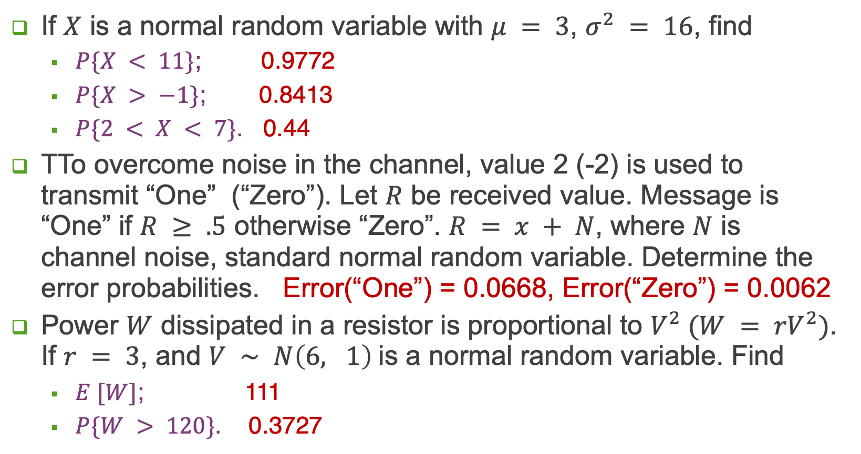
Exercises
If $X$ is a normal random variable with $μ = 3$, $σ^{2} = 16$, find
$P\{X < 11\}$; 0.9772
$P\{X > −1\}$; 0.8413
$P\{2 < X < 7\}$. 0.44
TTo overcome noise in the channel, value 2 (-2) is used to transmit “One” (“Zero”). Let $R$ be received value. Message is “One” if $R ≥ .5$ otherwise “Zero”. $R = x + N$, where $N$ is channel noise, standard normal random variable. Determine the error probabilities. Error(“One”) = 0.0668, Error(“Zero”) = 0.0062
Power $W$ dissipated in a resistor is proportional to $V^{2} (W = rV^{2})$. If $r = 3$, and $V ∼ N\left(6, 1\right)$is a normal random variable. Find
$E [W]$; 111
$P\{W > 120\}$. 0.3727

Slide 20
Confidence Interval
An interval $[L, U]$is said to be confidence interval if
$P( L ≤ θ ≤ U) = 1 – α$
In other words, probability of $θ$ being within $[L, U]$ is very large
$[L, U]$is a $100∗(1 – α) \%$interval
Two-sided interval, $L ≠ −∞, U ≠ ∞$
Divide $α$ by two.
On distribution, identify $L$ such that $P[−∞, L) = α/2$
On distribution, identify $U$ such that $P[U, ∞) = α/2$
One-sided interval: confidence interval can be made as well, by cutting off probability $α$ from only one side of the distribution

Slide 21
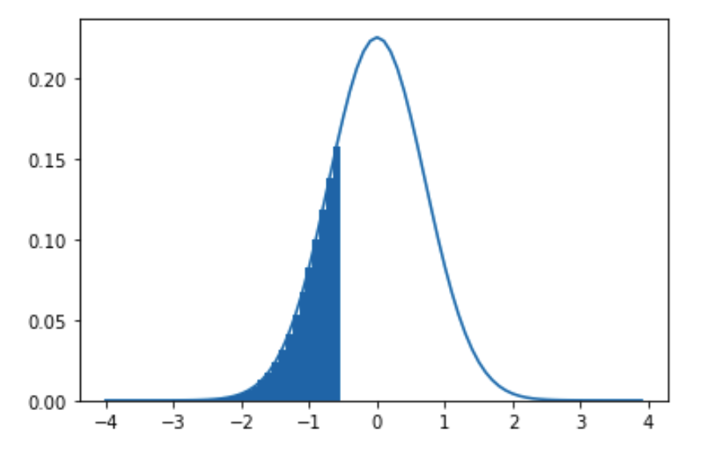
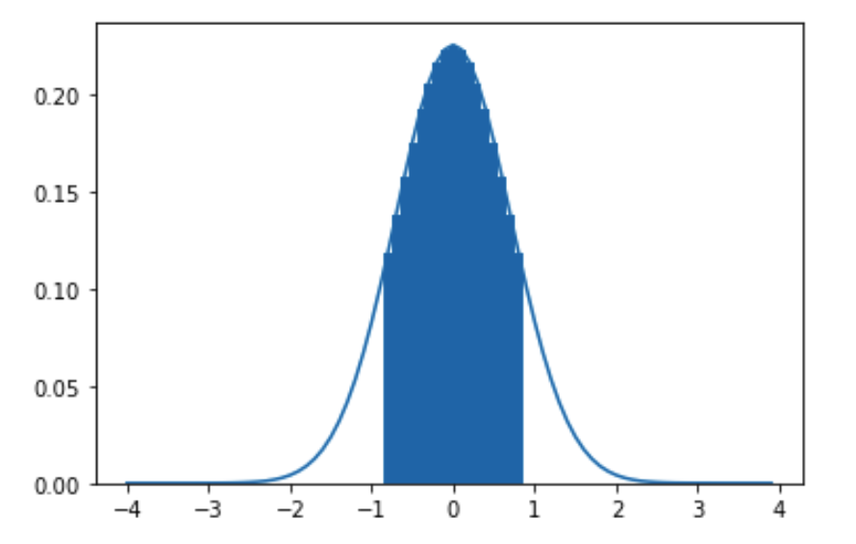
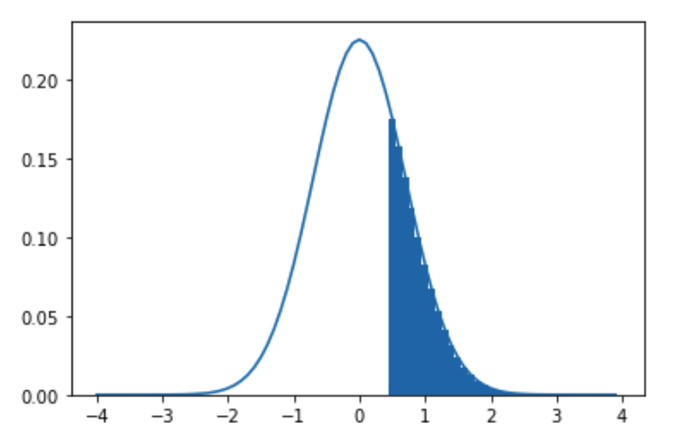
Confidence Interval
One tailed
Two tailed

